Slide 1
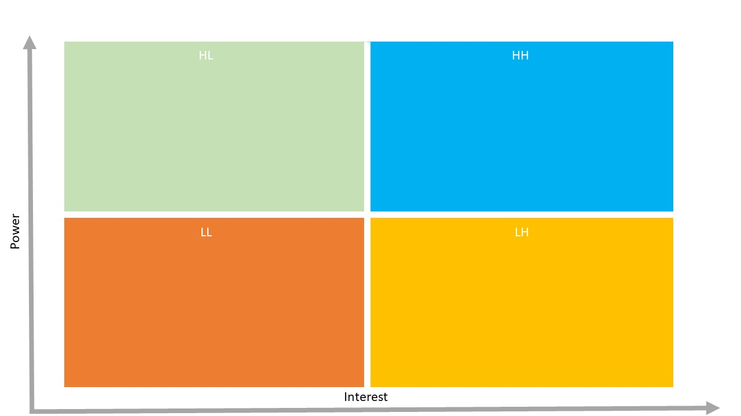
External Suppliers
CEO
Operations Manager
Procurement Manager
Finance Director
Board of Directors
Supply chain team
Warehouse Staff
Marketing Team
Production Team
CRM Manager

